Slide 1
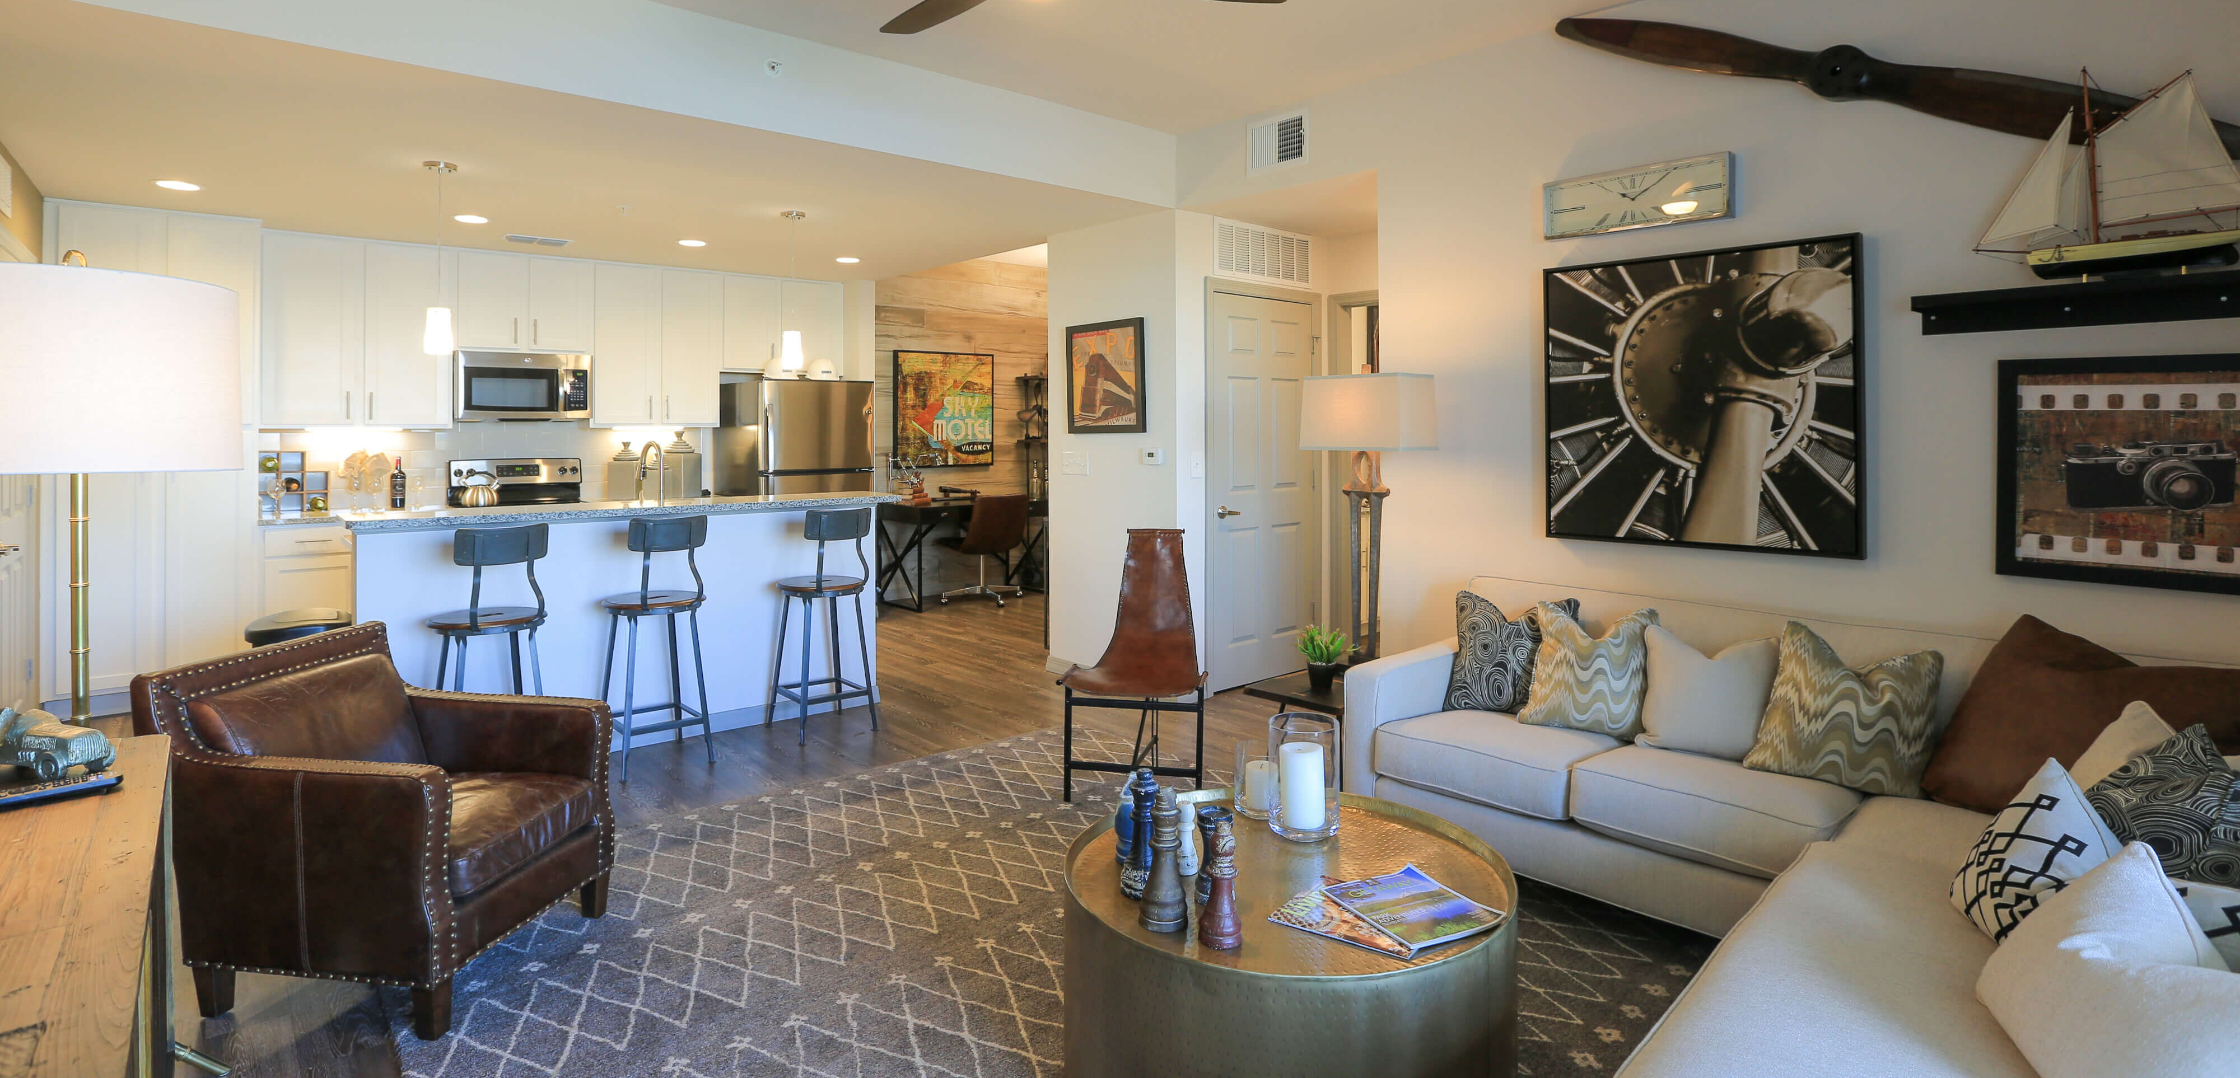
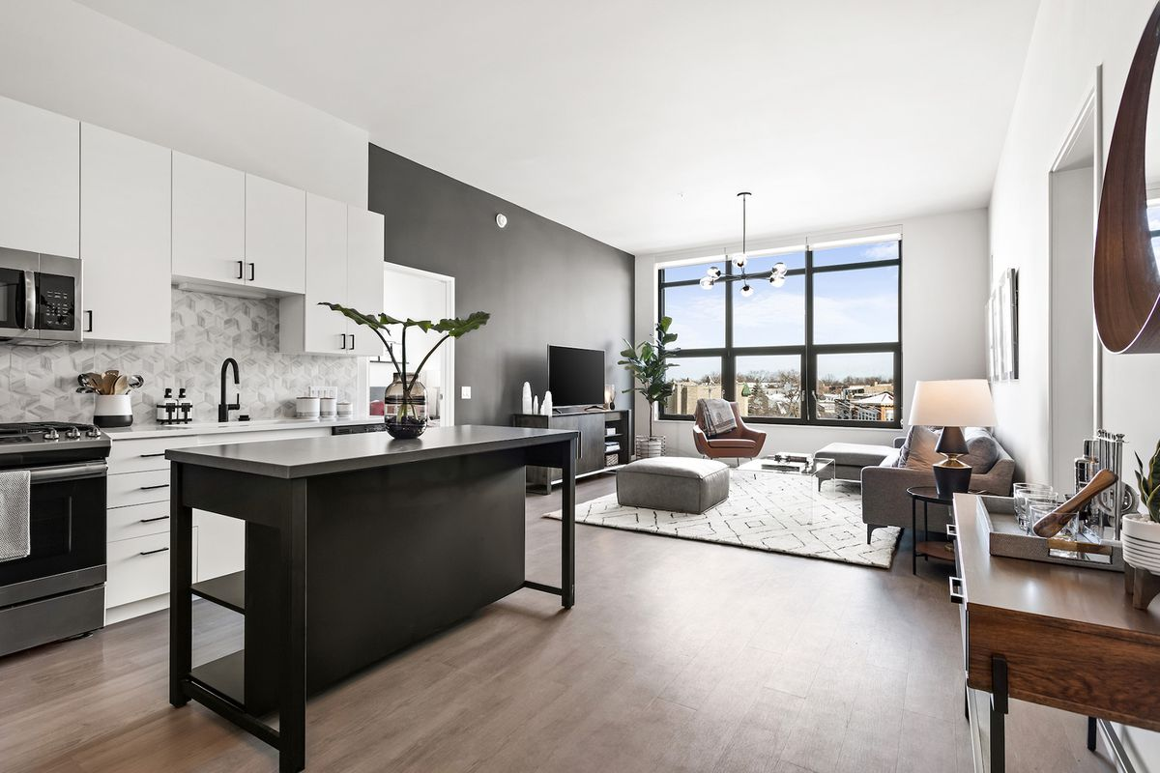
RENT-IT-OUT
INFO 6210 DATA MANAGEMENT AND DATABASE DESIGN
BHUMIKA PUNJABI – 001061256
PRANATHA RAJPRASAD RAO – 001023759
ANISH NAIK –
YASH -

Slide 2
OBJECTIVES
To ease user’s task whenever they need to rent a unit.
To transform the manual process of renting a house to an online and computerized system.
To validate the house rental system using user feedback and testimonies
To produce the documentation such as Software Requirement specification, Software Design Description and Software Development References

Slide 3
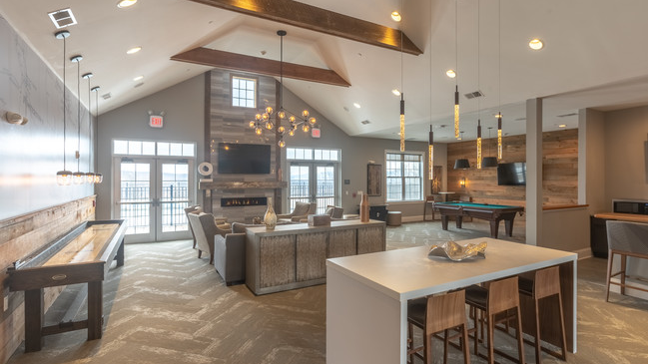
DESIGN APPROACH
WRITE ABOUT IT! (DISCUSS)

Slide 4
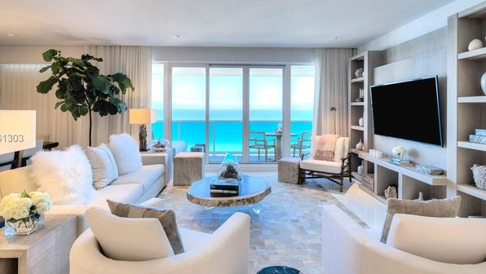
STORED PROCEDURE
GetUserInfo: TO GET USERS INFORMATION WHO HAS RENTED THE PROPERTY

Slide 5
STORED PROCEDURE
LateFee: retrieves late fees of user if any

Slide 6
STORED PROCEDURE
LateFee: retrieves late fees of user if any

Slide 7
STORED PROCEDURE
Output-late Fee value updated in the Table

Slide 8
STORED PROCEDURE
GetRemainingAmount: Checks Pending Payment of user(rentier)

Slide 9
STORED PROCEDURE
PropertyAvaliability: Check Availability Status of a Property Unit

Slide 10
FUNCTIONS
To retrieve best property in terms of crime rate and facilities available

Slide 11
FUNCTIONS
Function to retrieve Property details

Slide 12
TRIGGERS
Trigger to generate first payment(monthlyrent +securitydeposit) required by the user for each unit

Slide 13
TRIGGERS
Trigger to track payment made by User(tenant)

Slide 14
VIEWS
View for Unit Count by User

Slide 15
VIEWS
View showing Facilities Available near the Property

Slide 16
VIEWS
View showing Unit Features

Slide 17
COMPUTED DATA ENCRYPTION
Column Data Encryption on User’s Password

Slide 18
